Slide 1
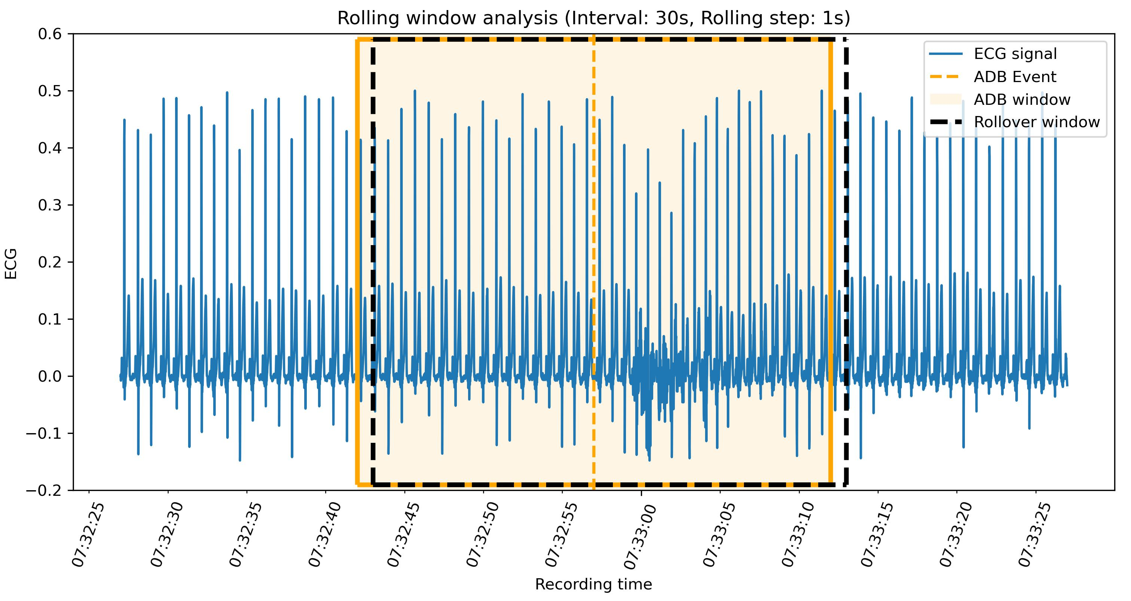
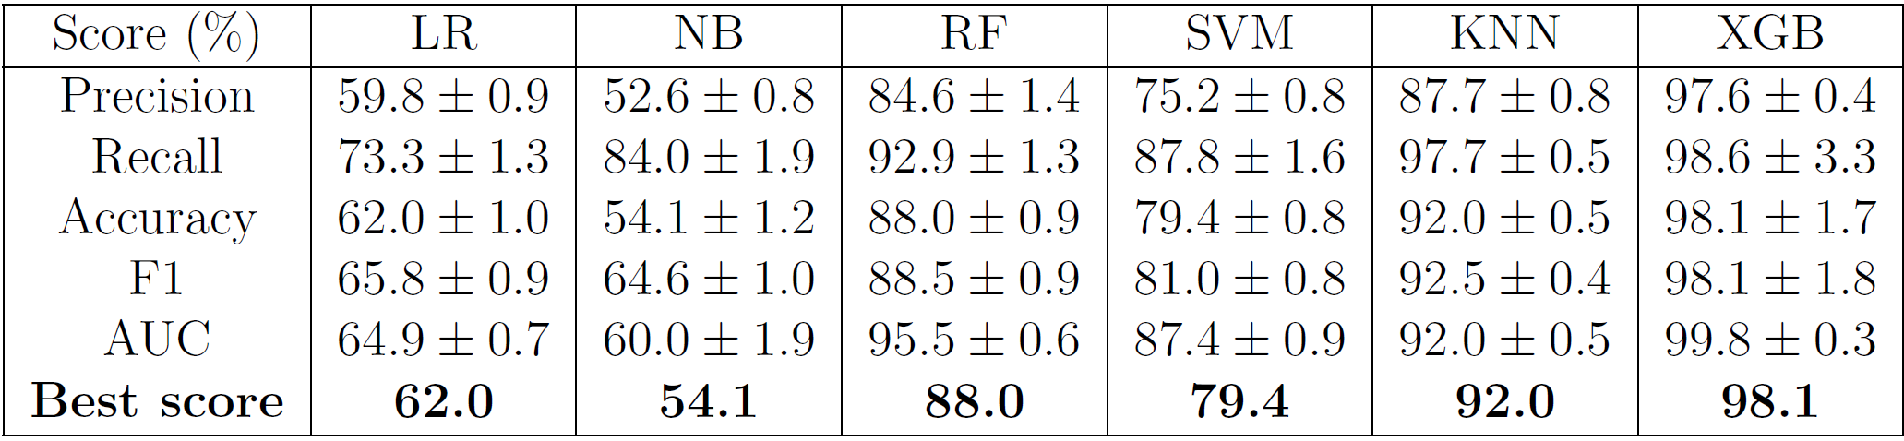
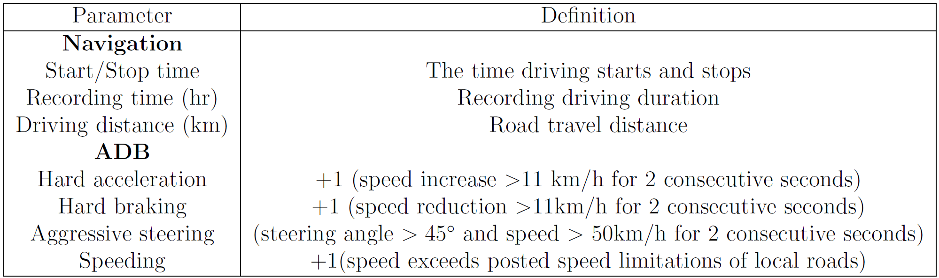
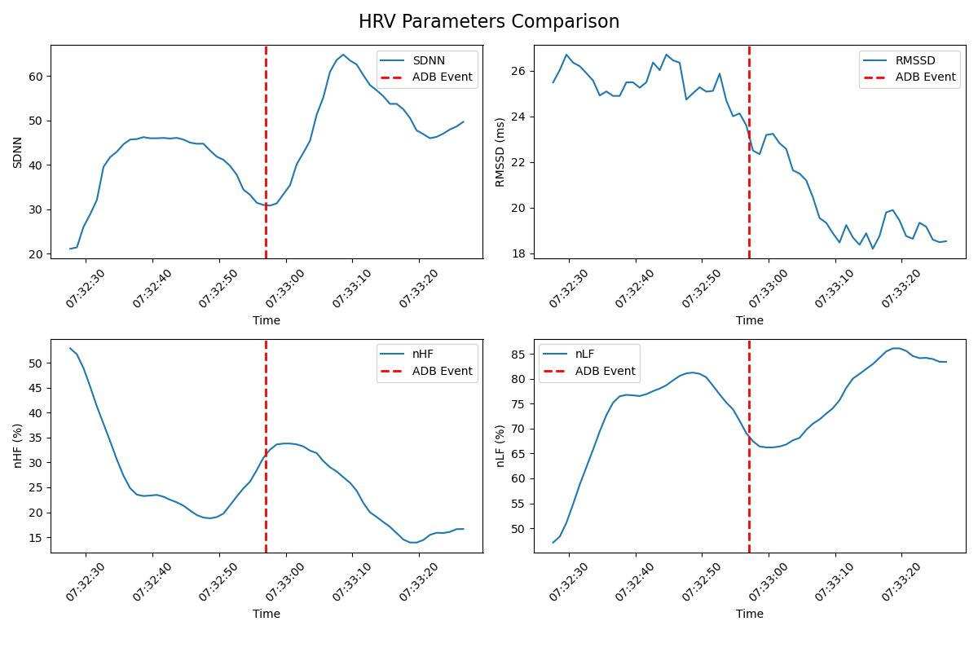
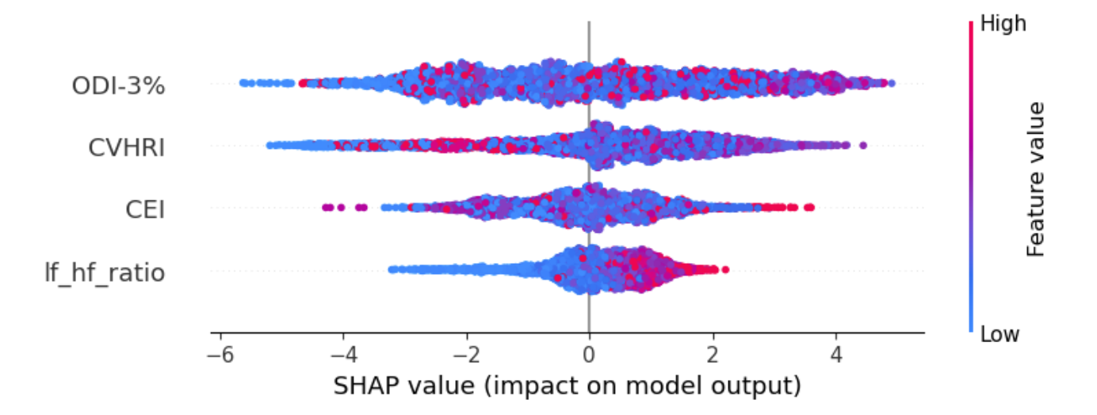
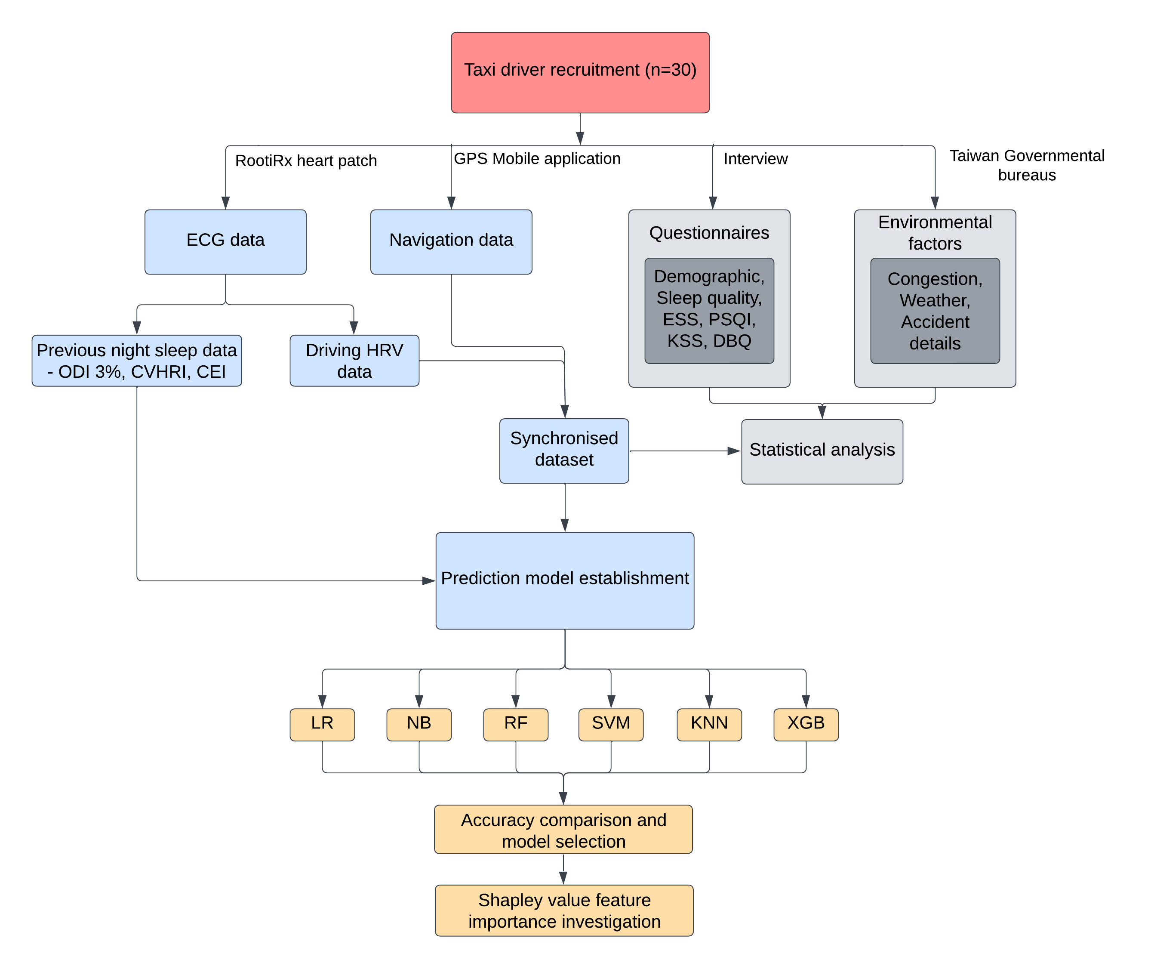
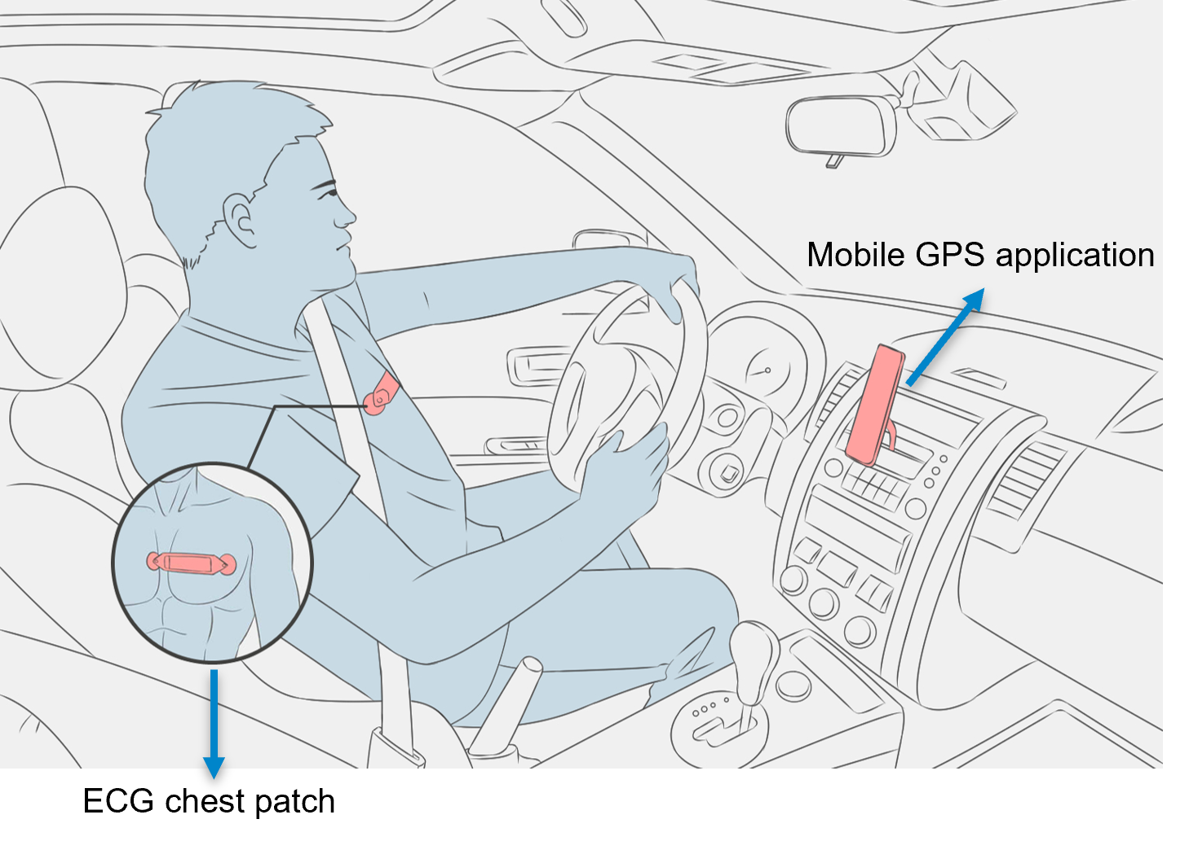
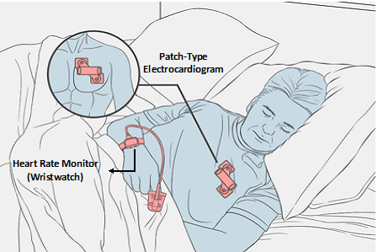
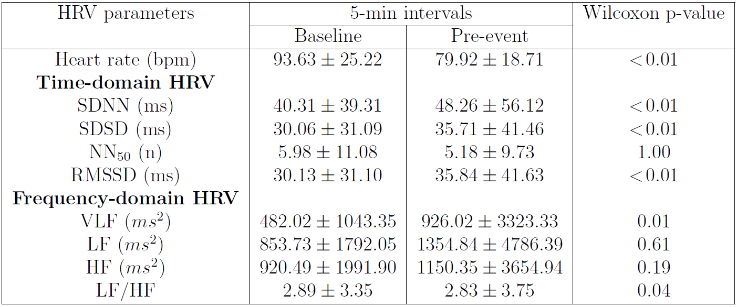
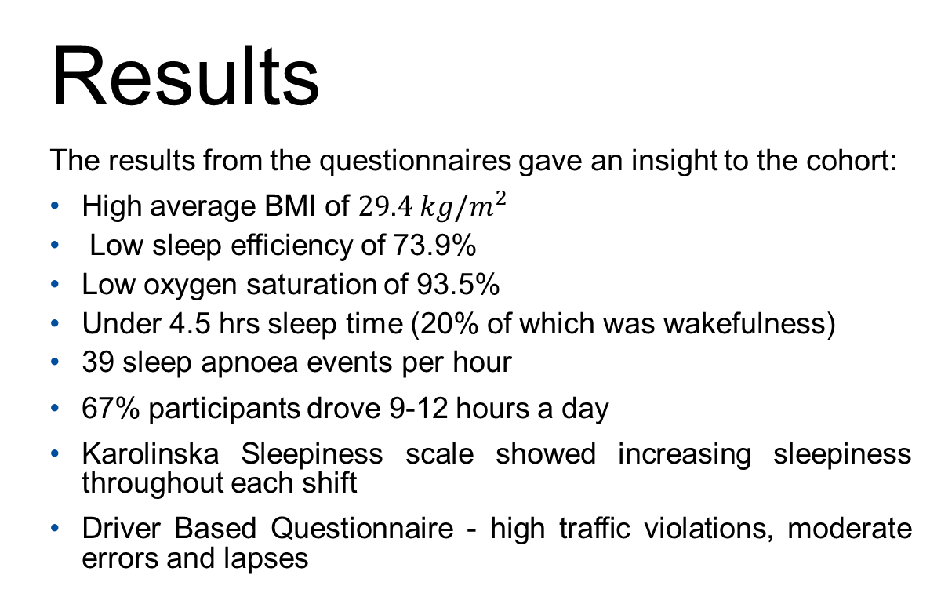
AI model establishment for aberrant driving behaviour detected by wearable technology
William Wang
Background
Road traffic crashes rank as the 8th leading cause of death with 1.35 million lives lost annually. Additionally, these crashes result in 50 million non-fatal injuries, leading to disabilities.
Investigating the role of human behaviour in traffic accidents is crucial as 95% of incidents are attributed to human imperfections. The use of physiological factors to detect fatigue in drivers has been explored in recent years and trends can be identified using heart rate variability.
Developments in artificial intelligence and machine learning have led to model development which can be used to predict ADB and increase the safety of road traffic, reducing the risk of crashes.
This study uses heart rate variability (HRV) collected during real-driving to predict aberrant driving behaviour (ADB) using machine learning (ML) models including Linear Regression (LR), Naïve Bayes (NB), Random Forest (RF), Support Vector Machine (SVM), K-Nearest Neighbour (KNN) and Extreme Gradient Boosting (XGBoost).
Aims and objectives:
Methodology
30 taxi drivers were recruited from Taipei, Taiwan and tracked for 4 days to gather their heart rate and driving data.
The heart rate data were collected using a RootiRx chest patch which utilised electrocardiogram technology. The driving behaviour data was tracked with a mobile application using GPS. Questionnaires were collected to provide demographic information, polysomnography parameters and driver fatigue levels. Environmental factors were obtained from the Taiwan National Bureaus. Statistical analysis was performed, and prediction models for aberrant driving behaviour were developed.
Live driving information, including speed, direction, acceleration, and position, was recorded during the driving sessions. ADB events were defined as follows:
Comparison of the baseline and pre-event 5-minute intervals revealed a statistical decrease in heart rate at pre-event. There were also increases in both time and frequency-domain features.
The establishment of the machine learning models saw high accuracies in the Random Forest, K-Nearest Neighbour and Extreme Gradient Boosting models (88%, 92% and 98%). Linear Regression and Naïve Bayes performed poorly, and Support Vector Machine scored 79%.
Rolling window analysis of ECG signal with a 30s and 1s rollover and HRV parameters comparison
Results
The results from the questionnaires gave an insight to the cohort:
High average BMI of $29.4 kg/m^{2}$
Low sleep efficiency of 73.9%
Low oxygen saturation of 93.5%
Under 4.5 hrs sleep time (20% of which was wakefulness)
39 sleep apnoea events per hour
67% participants drove 9-12 hours a day
Karolinska Sleepiness scale showed increasing sleepiness throughout each shift
Driver Based Questionnaire - high traffic violations, moderate errors and lapses
The Shapley values highlighted the importance of previous night’s sleep data in predicting aberrant driving behaviour. The LF:HF ratio was the most important HRV parameter.
Discussion
High BMI, neck sizes and waist sizes suggest the chosen cohort were at risk from obesity-related sleep disorders. Low sleep efficiency and decreased oxygen saturation indicated disturbances which lead to significant impairments and double the probability of a crash compared to well-rested individuals. The results confirmed the importance of including sleep data in ADB predicting ML models.
A reduction in heart rate, significant increases in SDNN and RMSSD, and a decrease in the LF:HF ratio suggested a shift towards parasympathetic nervous system dominance which is responsible for promoting relaxation. This suggested that drivers experienced drowsy driving just before committing aberrant driving behaviour.
Review existing literature
Investigate statistics
Process data
Establish ML models
Assess models
To assess the participants’ heart rate and sleep quality, the RootiRx chest patch monitored the ECG signals. The previous night sleep data included the Oxygen Saturation Index, the Cyclic Variation of Heart Rate Index and the Chest Effort Index.
Preprocessing steps were applied to the raw ECG signal using the hrv-analysis Python package. Irregular ectopic beats were removed and normal-to-normal intervals outside the range of 30 to 200bpm were filtered out. A sliding window analysis approach was employed to calculate the HRV features for 30s windows. A rollover step of 1s was used to capture the dynamic changes in HRV over time.
Time and frequency domain features of the heart rate variability were calculated for each window. These were synchronised with the driving data to separate ADB and normal driving intervals. 5-minute intervals were compared to predict ADB events.
Illustrations of the recording set-up for daytime driving behaviour and nighttime sleep parameters.
Density scatter plot of Shapley values for feature analysis
Figure to show the HRV parameters comparison.
Conclusion
In conclusion, this study successfully met its aims and demonstrated the effectiveness of utilising previous night sleep data and HRV parameters for predicting ADB.
The developed machine learning models, particularly the XGB model, exhibited 97.9% test accuracy and showcased their potential for real-world application.
By achieving these aims, this research significantly contributes to the field of driver fatigue detection, providing valuable insights for the development of systems aimed at reducing the occurrence of aberrant driving behaviour.
Flowchart of the data collection for the study

